Slide 1
Sentiment Analysis

Slide 2

Movie Reviews

Slide 3
Introduction
Sentiment Analysis is text analytics with a purpose
Use of text measures to learn about the past and make predictions about the future
Opinion mining
Draws upon positive and negative word sets (lexicons, dictionaries) that convey human emotions or feeling
Design text measures that work
List-based measures / item – weighted measures / models for text classification
Training and test regiment in evaluation

Slide 4
Data Sets and Sources
Movie reviews data available from Mass et al.(2011)
Original source from IMDb
50,000 movie reviews with no associated ratings
Similarly sized training and test data sets
Three data set types in the corpus:
Review text with no ratings: identify word sets for sentiment text measures
Movie reviews with known ratings: training data for developing text measurement models
Movie reviews with known ratings: evaluating developed text measures

Slide 5
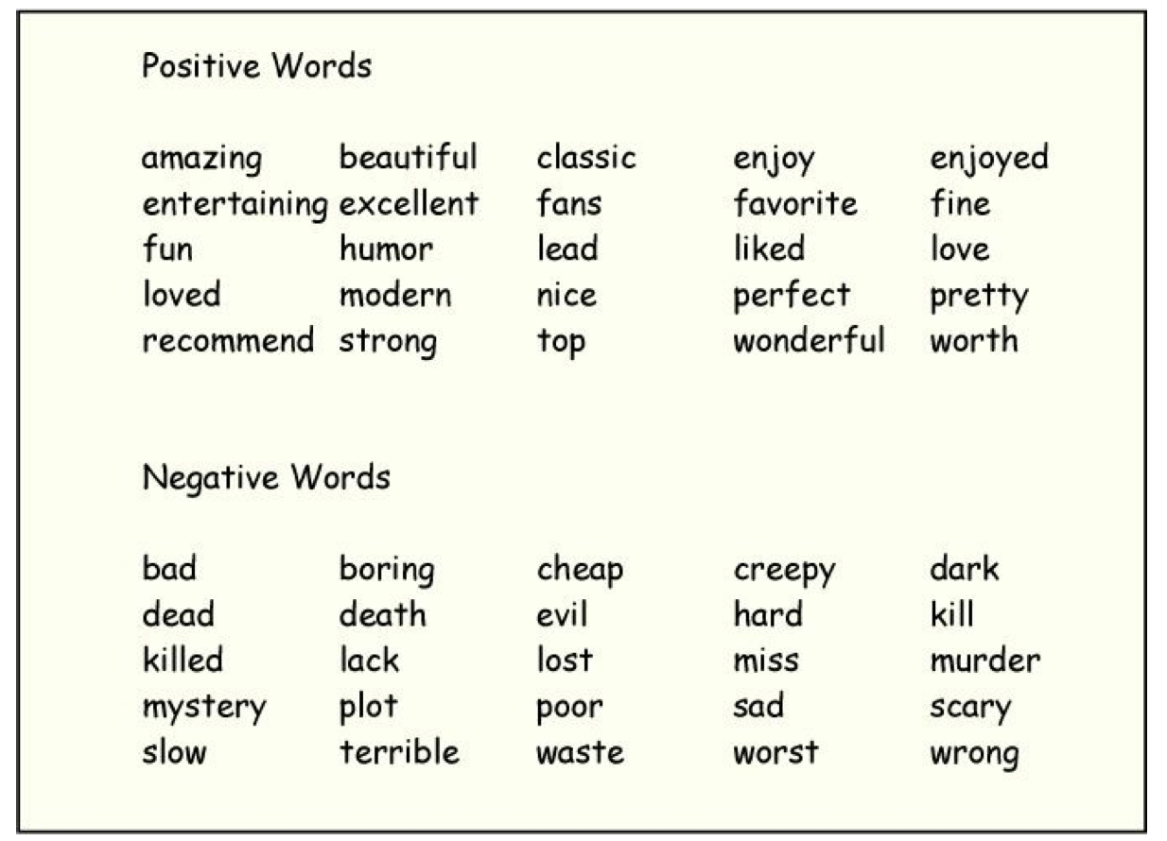
Lexicon worded for the data set with no ratings
Fifty words of sentiment:

Slide 6
Sentiment Analysis
There is nothing inherently good or bad about positive or negative words
Objective: Try to predict users’ ratings from the use of positive and negative words.
Count numbers of positive and negative words in each of the movie reviews
Compute two list –based text measures
POSITIVE: the percentage of words in the review that match up with the list of 25 positive words
NEGATIVE: the percentage of words in the review that match up with the list of 25 negative words

Slide 7
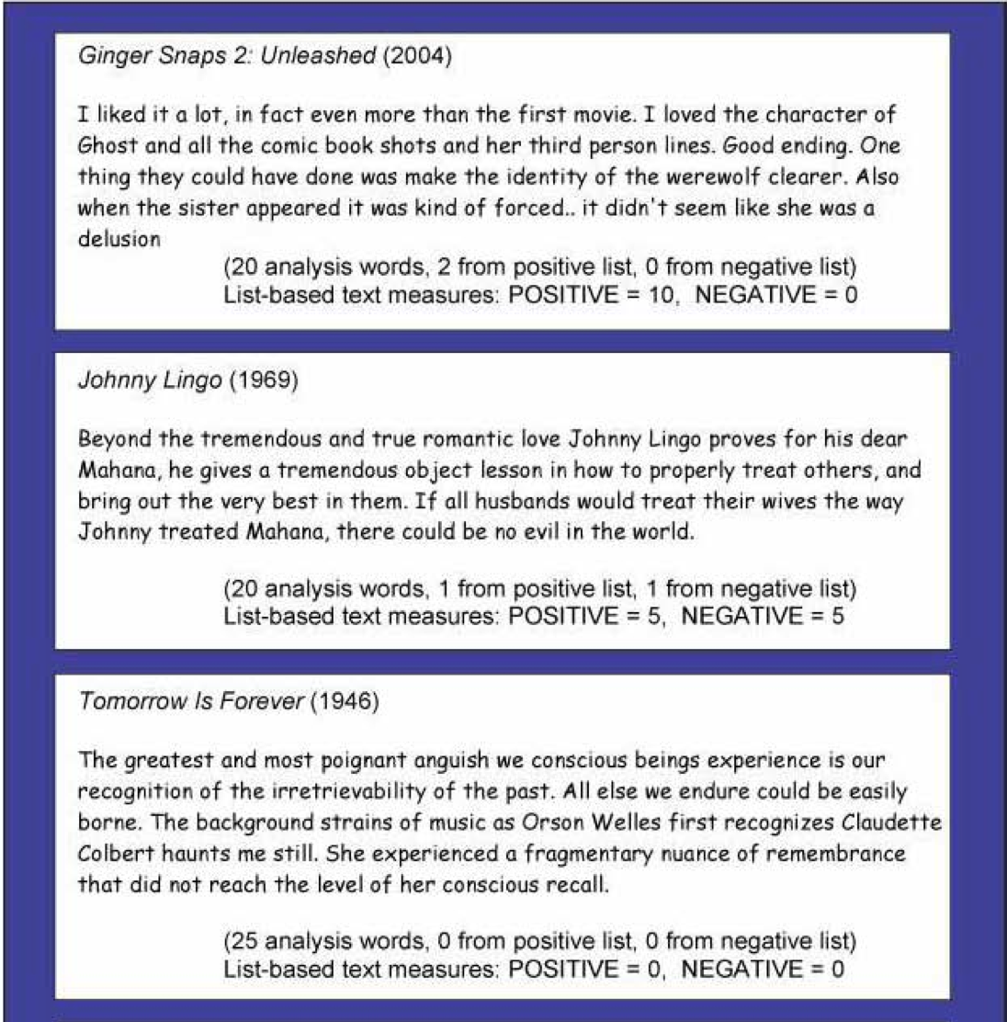
List – Based Text Measures
Four movie reviews and their associated POSITIVE and NEGATIVE scores.
First these reviews are filtered to remove stop words and account for stemming.

Slide 8
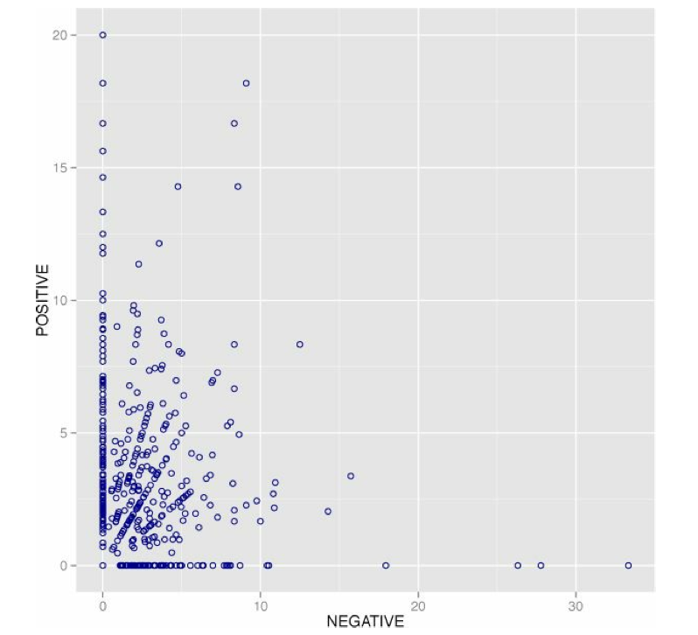
Scatter Plot of Text Measures of Positive and Negative Sentiment
How the two list-based measures play out across the set of 500 movie reviews
There is no much correlation between positive and negative.

Slide 9
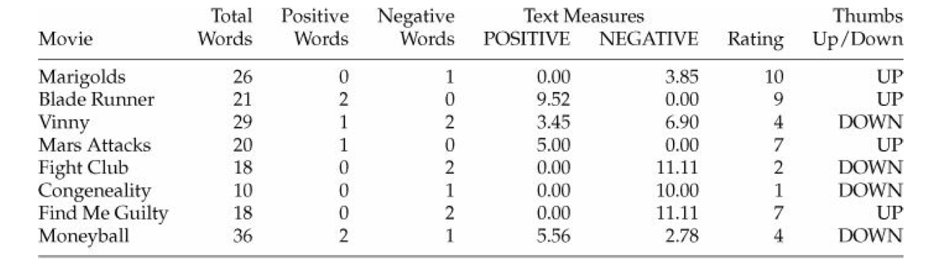
List – Based Measures
How do POSITIVE and NEGATIVE scores play out as far as eight movie reviews
The list – based measures are missing favorable ratings of Find Me Guilty and the unfavorable rating of Moneyball

Slide 10
Text Measures and Model development
Training set of movie reviews with known ratings:
1000 training movie reviews: 500 positive (ratings between 7 and 10) and 500 negative (ratings between 1 and 4)
1000 movie reviews for test set
Goal is to predict whether a movie review is a positive (ratings > 6) or negative (ratings < 5)

Slide 11
Six Measures and Modeling techniques
Simple difference
Difference scores (positive minus negative scores)
Regression difference
Use linear regression to determine weights to use for combining positive and negative scores into a linear predictor of ratings
Word/item analysis
Use original 50 words and training data to identify positive-leaning and negative-leaning words. Word weighted +1 for thumbs up or -1 for thumbs down

Slide 12
Six Measures and Modeling techniques
Logistic Regression
Stepwise logistic regression to select useful predictors from the set of 50 sentiment words
Support vector machines
Effective technique in text classification problems with large numbers of explanatory variables
Random forests
Ensemble method that uses thousands of tree – structured classifiers to arrive at a single prediction

Slide 13
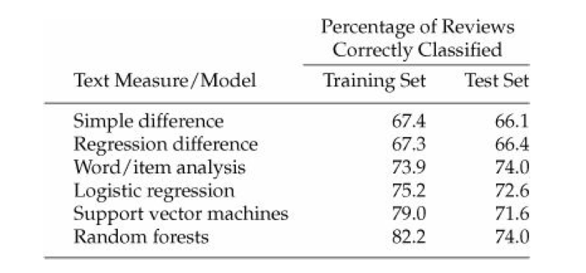
Comparison of different methods
Use the percentage of correct positive/negative predictions in the test set of movie reviews

Slide 14
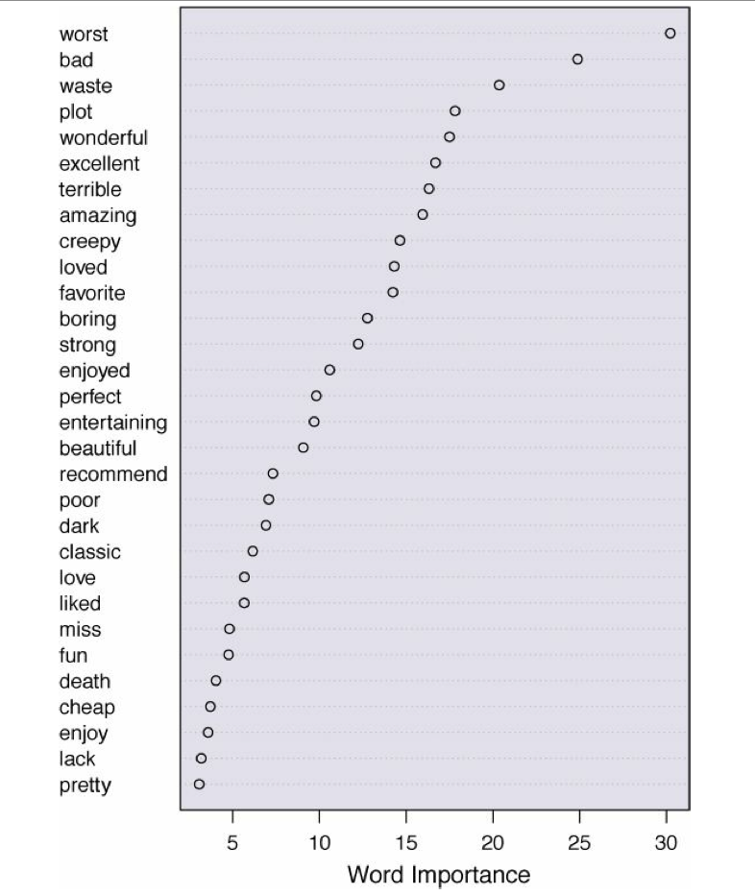
Word Importance
Word importance in classifying movie reviews provided by Random Forest:

Slide 15
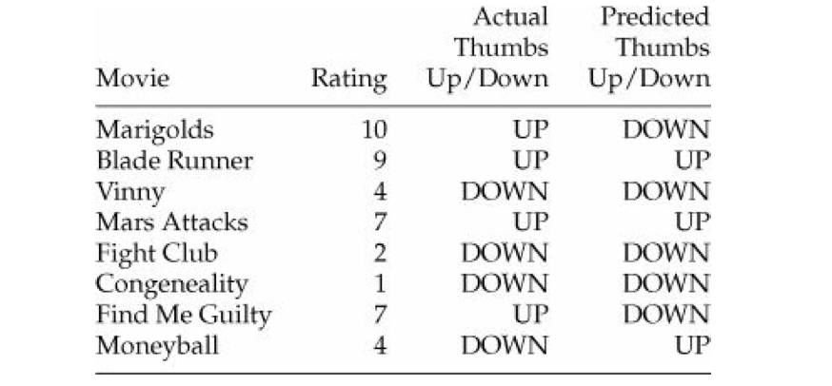
Random Forest Text Measurement
Random Forest applied to the eight movie reviews

Slide 16
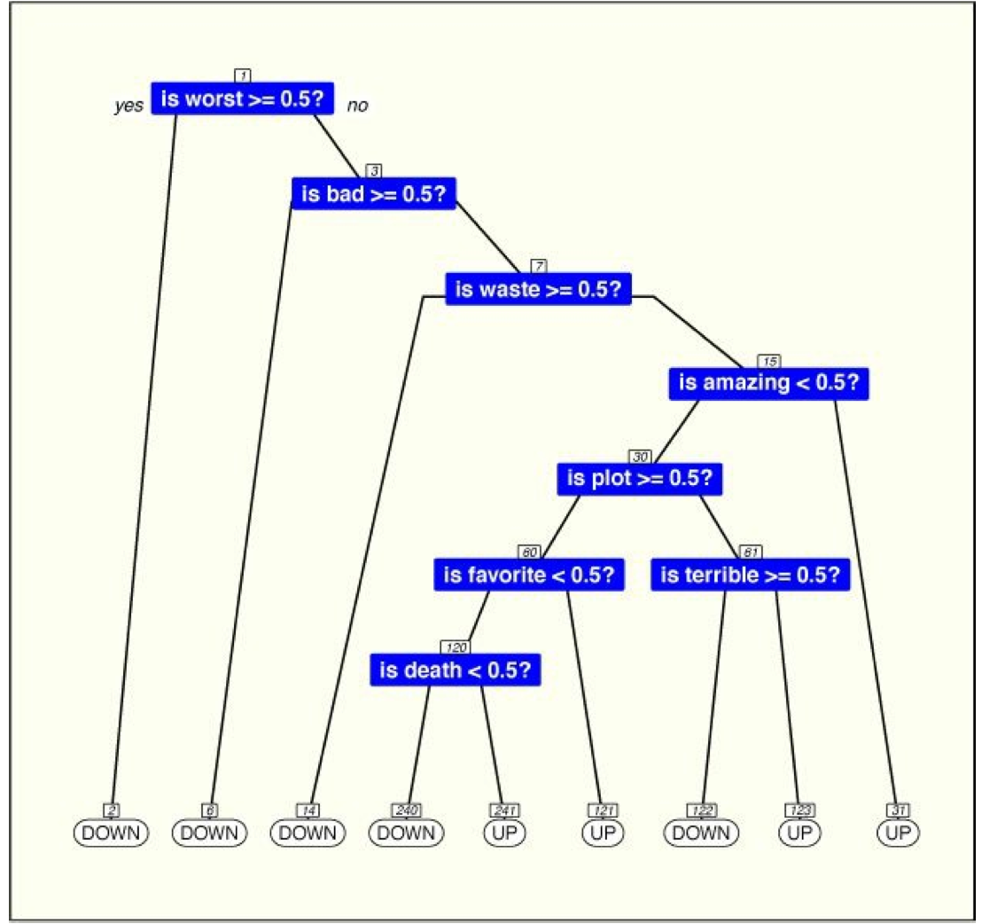
Simple Tree Classifier
If we are to classify on the basis of one word and one word alone – “worst”

Slide 17
Text Measures
Text Measures: the heart of sentiment analysis
Text measures are scores on attributes that describe text.
Used to assess personality, consumer preferences and political opinions
Begin with unstructured text as input data
Holds promise as a technology for understanding consumer opinion and markets
Sentiment Analysis
Is the assignment of numbers to attributes according to rules
Examine word sets and gain agreement

